Slide 1
Introduction to UNIX / Linux
BHAVANA
DAY 29
14/05/2024

Slide 2
What is an Operating System?
The operating system (OS) is the program which starts up when you turn on your computer and runs underneath all other programs - without it nothing would happen at all.
In simple terms, an operating system is a manager. It manages all the available resources on a computer, from the CPU, to memory, to hard disk accesses.
Tasks the operating system must perform:
Control Hardware - The operating system controls all the parts of the computer and attempts to get everything working together.
Run Applications - Another job the OS does is run application software. This would include word processors, web browsers, games, etc...
Manage Data and Files - The OS makes it easy for you to organize your computer. Through the OS you are able to do a number of things to data, including copy, move, delete, and rename it. This makes it much easier to find and organize what you have.

Slide 3
UNIX History
The UNIX operating system was born in the late 1960s. It originally began as a one man project led by Ken Thompson of Bell Labs, and has since grown to become the most widely used operating system.
In the time since UNIX was first developed, it has gone through many different generations and even mutations.
Some differ substantially from the original version, like Berkeley Software Distribution (BSD) or Linux.
Others, still contain major portions that are based on the original source code.
An interesting and rather up-to-date timeline of these variations of UNIX can be found at http://www.levenez.com/unix/history.html.

Slide 4
General Characteristics of UNIX as an Operating System (OS)
Multi-user & Multi-tasking - most versions of UNIX are capable of allowing multiple users to log onto the system, and have each run multiple tasks. This is standard for most modern OSs.
Over 30 Years Old - UNIX is over 30 years old and it's popularity and use is still high. Over these years, many variations have spawned off and many have died off, but most modern UNIX systems can be traced back to the original versions. It has endured the test of time. For reference, Windows at best is half as old (Windows 1.0 was released in the mid 80s, but it was not stable or very complete until the 3.x family, which was released in the early 90s).
Large Number of Applications – there are an enormous amount of applications available for UNIX operating systems. They range from commercial applications such as CAD, Maya, WordPerfect, to many free applications.
Free Applications and Even a Free Operating System - of all of the applications available under UNIX, many of them are free. The compilers and interpreters that we use in most of the programming courses here at UMBC can be downloaded free of charge. Most of the development that we do in programming courses is done under the Linux OS.
Less Resource Intensive - in general, most UNIX installations tend to be much less demanding on system resources. In many cases, the old family computer that can barely run Windows is more than sufficient to run the latest version of Linux.
Internet Development - Much of the backbone of the Internet is run by UNIX servers. Many of the more general web servers run UNIX with the Apache web server - another free application.

Slide 5
Parts of the UNIX OS
The Kernel - handles memory management, input and output requests, and program scheduling. Technically speaking, the kernel is the OS. It provides the basic software connection to the hardware. The kernel is very complex and deals with the inner workings of these things, and is beyond the scope of this course. The kernel is covered in detail in “Operating Systems.”
The Shell and Graphical User Interfaces (GUIs) - basic UNIX shells provides a “command line” interface which allows the user to type in commands. These commands are translated by the shell into something the kernel can comprehend, and then executed by the kernel.
The Built-in System Utilities - are programs that allow a user to perform tasks which involve complex actions. Utilities provide user interface functions that are basic to an operating system, but which are too complex to be built into the shell. Examples of utilities are programs that let us see the contents of a directory, move & copy files, remove files, etc...
Application Software & Utilities – these are not part of the operating system, per se. They are additional programs that are bundled with the OS distribution, or available separately. These can range from additional or different versions of basic utilities, to full scale commercial applications.

Slide 6
Flavors of UNIX
These can be grouped into two categories: Open Source and Proprietary
Proprietary: (redistribution and modification prohibited or restricted; not free)
Solaris - Access to a Solaris UNIX server (solaris.gl.umbc.edu) via SSH access.
IRIX - There are a couple of IRIX machines in the basement of the library, as well as server access (irix.gl.umbc.edu) via SSH access.
Mac OS X - no access currently available at UMBC.
and many others...
Open Source: (source code is readily available and free to modify)
FreeBSD - no access currently available at UMBC.
Linux Distributions - access is available in the form of dual-boot PCs scattered throughout the Engineering building. There are also several Linux servers (linux.gl.umbc.edu) through which access is available.
RedHat (used by UMBC) and the Fedora Project (maintained by RedHat)
Mandrake
Debian
SuSE
Slackware
and many others...
As a side note, Linux is a open source UNIX-based OS that was originally developed in 1991 by Linus Torvalds, a Finnish undergraduate student.

Slide 7
UNIX Interfaces
There are really 2 means of connecting to UNIX computers here at UMBC:
You can be sitting in front of a dual-bootable PC that you have booted into Linux and logged onto. All of your commands are then being run locally on that computer. When you logon in this manner you have a full GUI environment.
You can connect remotely to one of the UNIX servers (whether from home or at the labs). This is often how your projects are suggested to be developed as they are graded on those same servers. When you logon in this manner you have a command line (or text based) environment. You can also open up a command line on local lab machines as well.

Slide 8
Graphical User Interfaces (GUIs)
When you logon locally, you are presented with graphical environment.
You start at a graphical login screen. You must enter your username and password. You also the have the option to choose from a couple session types. Mainly you have the choice between Gnome and KDE.
Once you enter in your username and password, you are then presented with a graphical environment that looks like one of the following...

Slide 9
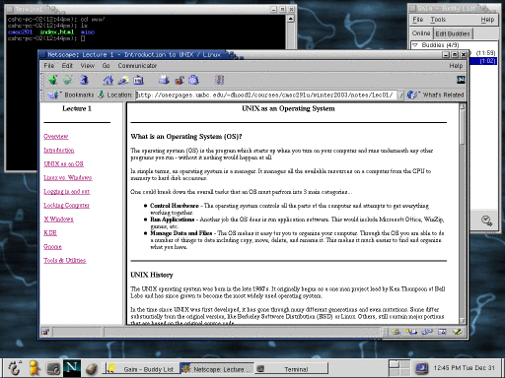
Gnome

Slide 10
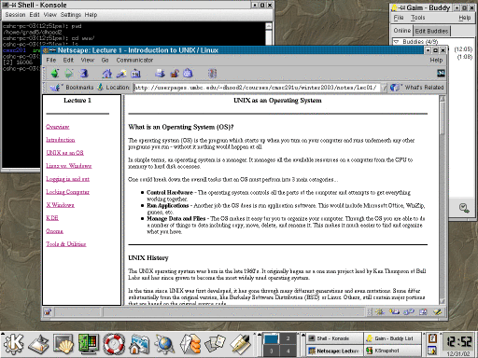
KDE

Slide 11
Command Line Interface
You also have access to some UNIX servers as well.
You can logon from virtually any computer that has internet access whether it be Windows, Mac, or UNIX itself.
In this case you are communicating through a local terminal to one of these remote servers.
All of the commands actually execute on the remote server.
It is also possible to open up graphical applications through this window, but that requires a good bit more setup and software. (Time permitting, we may cover how to do this.)

Slide 12
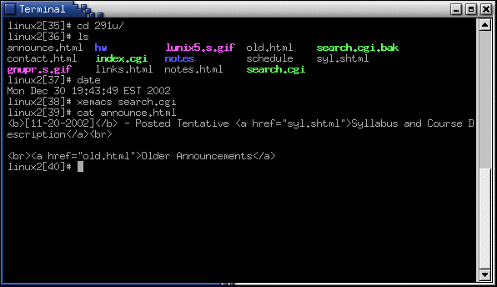
The Terminal

Slide 13
Linux vs. Windows
OS does not have to use a graphical interface.
The OS itself (the kernel) is incredibly small.
The GUI just another application (or set of applications) that can be installed and run on top the existing text-based OS.
File system differences.
Windows typically uses FAT32 or NTFS file systems.
Linux typically uses the ext2 or ext3 file systems
In much larger research and university environments, where file access is necessary across the network, something like Network File System (NFS) or the Andrew File System (AFS) is used. We use AFS here on GL at UMBC.
Windows lists all drives separately (A:,C:,D:, etc…), with “My Computer” at the highest level.
UNIX starts its highest level at “/” and drives can be mounted anywhere underneath it.

Slide 14
UMBC’s Computing Environment
You need a GL account username and password!
Since almost all UNIX systems are multi-user systems you will need to have a logon name and password to authenticate yourself to the system. At UMBC, when you signup for a GL account, you are given a username and password, which is your means of logging on to any computer system, be it UNIX, Windows or Mac.
Where is UNIX / Linux available?
There are many labs in the Engineering (ENG) building where there are dual-bootable Windows and Linux PCs. You can simple reboot one of these machines and select Linux as the operating system.
There are also a couple of other places across the campus where you can sit directly in front of a UNIX computer. UMBC's Office of Information Technology (OIT) maintains a list of the labs it maintains as well as descriptions about the operating systems in those labs.
This list is online at http://www.umbc.edu/oit/classroomtechnology/labs/lablocation.html.

Slide 15
Practical Tasks
Rebooting the computer into Linux on a dual-boot PC.
Logging in.
Locking the screen.
Logging out.
The non-graphical terminal!
Press Ctrl-Alt-F2 then login
Be sure to logout with the command “logout”
Press Ctrl-Alt-F7 to get the GUI back.

Slide 16
If all else fails in Gnome or KDE
If your session seems to have froze up, you can press ctrl-alt-backspace to restart the X window server, in the process logging you out.
Note that by doing it this way, you risk losing unsaved work.

Slide 17
What is X Window?
X window is the program that draws windows on the screen under most GUI-based versions of UNIX. It is important to note that the language that X windows speaks is completely different from that of Microsoft Windows or Mac OS X.
Any X window system consists of 2 distinct parts - the X server and 1 or more X clients.
The server controls the display directly, and is responsible for all input/output via the keyboard, mouse or display.
The clients, on the other hand, do not access the screen directly - they communicate with the server, which handles all input and output.
It is the clients which do the "real" computing work - running applications or whatever.
The clients communicate with the server, causing the server to open one or more windows to handle input and output for that client.

Slide 18
What’s the deal about the X Window Server and Client?!
The X window server runs on the machine to which the monitor is connected.
The clients may also run on this machine, communicating directly with the server. On most workstations, this is the normal situation. However, X is a networked window system, and it is possible for the client to run on a remote machine, communicating with the server via some form of network.
It is possible to connect to one of the UMBC servers and launch graphical applications from one of the UNIX servers.
This does require that an X window server is installed on the machine from which you are connecting from. This is automatically running if you are running a GUI UNIX system.
You can also install an X window server on top of Microsoft Windows, so that you can open up windows locally that are talking to the server at UMBC. Like I said earlier, this does require installing some software on the client side, and time permitting we may talk about this later in the course.

Slide 19
What is a Desktop Manager?
Gnome and KDE are examples of desktop managers. Both of these look a lot like Microsoft Windows.
They have the equivalent of a Start Menu, have an equivalent of Windows Explorer, and have some sort of control panel.
The roll of the Desktop Manager is to provide you with the ability to manage all of the details of your system that would otherwise require you to type in a bunch of commands in a terminal window.
These details include managing your files, launching programs, configuring various aspects of your system, etc.
It is also worthy to note that the desktop manager is optional. Many older systems did not have a desktop manger that sat in-between the X server and the Window manager.

Slide 20
What is a Window Manager?
The Window Manager is a program that manages the placement of Windows on your system. The Window Manager makes it possible to move, resize, and minimize the various programs running on your computer
KDE handles this functionality as well, whereas Gnome does not directly provide this functionality, but rather relies on an independent window manager to do it for us.
Think of the Window Manager as the framing around the windows as well as all of the associated functionality that they provide.
For example, most all window managers can close, minimize, maximize & resize.
However most UNIX window managers add so much more in the way of functionality. The decoration and customization of these windows under UNIX tends to be much more flexible.
Many Window Managers also provide other functionality such as shading, sticky/nonsticky, window history, and desktop and workspace manipulations.

Slide 21
Some Notes on X window, Desktop Managers & Window Managers
Most UNIX systems can be installed without the GUI.
The GUI is just another application that runs on top of the operating system.
There are many implementations of all three of these components.
It is possible to mix and match implementation and versions of these.
They need not be alike and need not be all by the same organization.
This is quite a shift in paradigm from Microsoft and Apple.

Slide 22
Programming Tools and Utilities Available under Linux
Text Editors
Xemacs
Emacs
Pico
vi
Compilers
C compiler - gcc
C++ compiler - g++
Java compiler & Java Virtual Machine - javac & java
Debuggers
C / C++ debugger - gdb
Interpreters
Perl - perl
Tcl/Tk - tcl & wish
Miscellaneous
Web Browsers - Mozilla, Netscape, Firefox, and Lynx (lynx is text based)
Instant Messengers - Gaim
Email - Netscape is there, but we will learn Pine

Slide 23
Advanced Commands and Unix Tools

Slide 24
The History
Almost every shell stores the previous commands that you have issued.
Most shells allow you to press the up arrow to cycle through previous commands. These previous commands are what makes up the history.
You can save some time typing by reusing previous commands. You can execute them exactly as they are or make small alterations as needed.
The history command shows us the history list of previous commands.
linux2 [6]# history
1 20:32 ls
2 20:32 cd courses/
3 20:32 ls
You can clear the history using history –c.

Slide 25
Bang (!)
We can access commands in the history and re-execute them using an exclamation mark (!).
Many UNIX users refer to this as “bang”.
We can type ! followed by a history number to re-execute that command:
linux2 [4]# history
1 21:47 gcc hello.c
2 21:47 a.out
linux2 [5]# !1
gcc hello.c
We can also type ! followed by the first character(s) of that command.
When there are multiple matches, the shell will always execute the most recently executed match
linux2 [7]# history
1 21:47 gcc hello.c
2 21:49 gcc round.c
3 21:49 history
linux2 [8]# !g
gcc round.c linux2
We can also always execute the most recently executed command by issuing the command !! (bang bang).

Slide 26
PATH
The PATH is nothing more than a list of directories in which to look for executable commands.
Note that if the same command lives in more than one of these places, the first one in the path listing is the one that is used.
To complicate this matter even more, the versions that are in these different directories may be different, as it the case with gcc (the C compiler) at the time of this writing.

Slide 27
whereis
The whereis command locates all instances of a command that may be in your PATH.
There are many bin (binary executable) directories scattered across the system and throughout your PATH.
There may be multiple copies (or even worse - versions) of the same command.
Example:
linux2 [23]# whereis bash
cp: /bin/bash /usr/local/bin/bash /usr/share/man/man1/bash.1.gz
There are 2 instances of bash, one in "/bin/" and "/usr/local/bin/".
Often times you may also get hits for the manpage entries as well (which is the last one that we are seeing).
There may be multiple versions of the same application in different places.
Example:
linux2 [27]# /bin/bash –version
GNU bash, version 2.05.8(1)-release (i386-pc-linux-gnu)
Copyright 2000 Free Software Foundation
linux2 [28]# /usr/local/bin/bash –version
GNU bash, version 2.03.0(1)-release (i686-pc-linux-gnu) Copyright 1998 Free Software Foundation

Slide 28
which
which tells which instance of a command is being executed when that command is run.
Typically, the specific instance that is being executed is the one that is first in your PATH.
However, there are some instances where which will return something other than a path name.
If commands are aliased or if the command is a built-in shell command, which may report that as well.
Example:
linux2 [41]# which gcc
/usr/local/bin/gcc
linux2 [42]# which mem
mem: aliased to quota –v
linux2 [43]# which time
time: shell built-in command

Slide 29
UNIX Tools: grep
The grep tool searches for lines matching a specific pattern.
The general form of the grep command is:
grep pattern files
Example:
linux2 [77]# grep “Jon" *.c
projaux.c: * Created by: Jon D. Smith
projaux.c: * Last Modified by: Jon Smith
There are also many flags that you can pass into grep (for a complete list, see the man pages).
-i : searches for the given pattern insensitive to case (matches both uppercase and lowercase)
-n: displays the numbers of the lines that match the target pattern
--recursive: searches from this working directory downward

Slide 30
grep Example
Example:
linux2 [78]# grep "Jon" *.c –i
proj.c: * Created by: JON D. SMITH
projaux.c: * Created by: Jonathan D. Smith
projaux.c: * Last Modified by: Jonathan D. Smith
linux2 [79]# grep “Jon" *.c –n
projaux.c:3: * Created by: Jon D. Smith
projaux.c:6: * Last Modified by: Jonathan D. Smith
linux2 [85]# grep “Jon" . --recursive
./avg.c: * Created by: Jonathan D. Smith
./coredump.c: * Created by: Jon D. Smith
./dir1/hello.c: * Created by: Jonathan D. Smith
./dir3/projaux.c: * Created by: Jonathan Smith
./dir3/projaux.c: * Last Modified by: Jonathan Smith
./dir3/projaux.h: * Created by: Jon Smith
./dir3/projaux.h: * Last Modified by: Jon Smith
./foo.c: * Created by: Jonathan D. Smith
./hello.c: * Created by: Jonathan D. Smith

Slide 31
UNIX Tools: find
The find tool searches for files in a directory hierarchy.
The general form for the find command is:
find path conditions
There are many conditions that you can check for (for a complete list see the man pages).
-name: look for files names that match a given pattern
-iname: does case-insensitive name matching
Example:
linux2 [95]# find . -name image.jpg ./dir1/subdir1/subsubdir/image.jpg
linux2 [96]# find . -name image

Slide 32
IO Redirection: stdin, stdout, and stderr
If you are familiar with C programming, you will remember scanf and printf.
For now it is sufficient to say:
scanf reads from stdin (the keyboard)
printf writes out to stdout (the screen via the console)
UNIX systems provide a facility of redirection that allow us to read from and write to places other than these defaults of the keyboard and the screen.

Slide 33
> Redirection of stdout (overwrite)
> allows us to send the output from stdout to somewhere other than the screen.
Example: Redirecting the linux date command to a file:
linux3-(6:28pm): date > output
linux3-(6:28pm): cat output
Sun Oct 6 18:28:32 EDT 2002
If we redirect stdout using a single > it will overwrite the contents of the file, erasing all previous contents.
linux3-(6:28pm): date > output
linux3-(6:28pm): cat output
Sun Oct 6 18:28:44 EDT 2002

Slide 34
>> Redirection of stdout (append)
Redirecting with >> appends to a file.
linux3-(6:30pm): date >> output
linux3-(6:30pm): cat output
Sun Oct 6 18:30:07 EDT 2002
Sun Oct 6 18:30:19 EDT 2002
Redirection of stdout is helpful if the amount of information printed to the screen is more than the screen can hold.
You can redirect the output to a file and then view it using less, more, cat, or the text editor of your choice.
Redirection of stdout is also useful to save the output of a program.

Slide 35
< Redirection of stdin
We can redirect stdin from a file.
linux3-(6:40pm): gcc -Wall -ansi avg.c -o avg
linux3-(6:40pm): avg
Enter the first integer: 1
Enter the second integer: 2
Average is: 1.500000
Rather than the user typing in the values, lets get them from a file. We will run the program once redirecting 1.dat as the input and again using 2.dat as the input...
linux3-(6:40pm): cat 1.dat
1 2
linux3-(6:40pm): avg < 1.dat
Enter the first integer: Enter the second integer: Average is: 1.500000
linux3-(6:40pm): cat 2.dat
1
2
linux3-(6:41pm): avg < 2.dat
Enter the first integer: Enter the second integer: Average is: 1.500000
scanf is smart enough to skip white space, whether it be a space or newlines. Nothing fancy is needed to handle whitespace.
Note: that the numbers being read in are not echoed to the screen.

Slide 36
Combining < and >
We can combine different types of redirection with a single command.
Example: the program will get input from the file called 1.dat, and redirect all of the program’s output to a file called output.
linux3-(6:41pm): avg < 1.dat > output
linux3-(6:41pm): cat output
Enter the first integer: Enter the second integer: Average is: 1.500000

Slide 37
>& Redirecting stderr
Lets examine the following output from the gcc compiler...
linux3-(6:42pm): gcc -Wall -ansi avg.c
avg.c:24: unterminated string or character constant
avg.c:19: possible real start of unterminated constant
This is a simple example where gcc finds 2 errors when it tries to compile a buggy version of avg.c. But what if we have so many errors that they all scroll off of the top of the screen and we are unable to see them all? Sound like a job for redirection of stdout to a file...
linux3-(6:42pm): gcc -Wall -ansi avg.c > output
avg.c:24: unterminated string or character constant
avg.c:19: possible real start of unterminated constant
linux3-(6:42pm): cat output
linux3-(6:42pm):
What happened? I told the compiler to direct the errors to a file, but they were printed to the screen and not the file like I told it.
Some programs print to the screen without using stdout. Often times errors and warnings are printed to another output buffer called stderr.
There are some cases where we may wish to redirect stderr to a file and look at them. Such as when we need to examine them but there are too many. Well to redirect the output we use the > followed by an & sign to tell it to redirect stderr as well...
linux3-(6:42pm): gcc -Wall -ansi avg.c >& output
linux3-(6:42pm): cat output
avg.c:24: unterminated string or character constant
avg.c:19: possible real start of unterminated constant

Slide 38
UNIX Tools: tar
The tar command is used for creating an archive of a directory hierarchy.
tar archives are a handy way of sending a bunch of files (or a program distribution) across the network or posting them on the internet.
Begin by creating a tar archive of the files.
Transmit that tar archive over the network or post it online.
Untar the files where you want them.
Usage:
Creating a tar archive:
tar –cvf <archive_name>.tar <files>
Viewing the contents of an archive:
tar –tvf <archive_name>.tar
Extracting a tar archive to the current directory:
tar –xvf <archive_name>.tar

Slide 39
tar Examples
Create a tar archive of your home directory and place it in your working directory:
tar –cvf myhome.tar home/
View the contents of the tar archive:
tar –tvf myhome.tar
Extract the tar archive to your current working directory:
tar –xvf myhome.tar
Creating, viewing, and extracting a tar archive
linux3[6]% tar -cf archive.tar file*.txt
file1.txt
file2.txt
linux3[7]% tar -tvf archive.tar
-rw-r--r-- eeaton1/rpc 4298 2005-09-26 10:19:02 file1.txt
-rw-r--r-- eeaton1/rpc 4441 2005-09-26 10:20:12 file2.txt
linux3[8]% mkdir temp
linux3[9]% cd temp
linux3[10]% tar -xvf ../archive.tar
file1.txt
file2.txt
linux3[11]% ls
file1.txt file2.txt

Slide 40
Advanced Command Chaining
We can use combinations of parenthesis, semicolons, i/o redirection, and pipes to create powerful commands:
Example: Copying a set of files while preserving timestamps:
(cd ~/courses; tar -cvf - CMSC121) |
(cd ~/../pub/courses/; tar -xvf -)
Note that this is a fancy way of doing what cp with the -r and --preserve flags already does.

Slide 41
Running Background Jobs
Jobs (a.k.a. commands) can be told to be run in the background by issuing the command followed by the ampersand symbol (&).
This starts the execution of the command, but allows immediate input from the terminal for other purposes (such as compilation).
When a command is issued with the ampersand, the shell prints out some information about the job.
First is the job number which is shown in square brackets, followed by the process ID number.
You may also see a line of information about that job.
Lastly the system prompt will be redisplayed for your next command.
When the job is completed, the shell will tell you that it is done. This typically does not happen immediately, but when the shell next gets to draw the prompt (after the next command).
linux1 [21]# emacs foo.c &
[1] 16819
linux1 [22]# gcc foo.c
foo.c: In function `main':
foo.c:19: parse error before `return‘
linux1 [23]# gcc foo.c
linux1 [24]#
[1] Done emacs foo.c
linux1 [24]#

Slide 42
Managing Processes
ps : lists the processes running on the machine.
ps -u username lists only your processes.
ps -a : lists all processes running on the machine.
The PID column of the listing, provides the information required by the kill command.
top : a more detailed method of observing processes.
nice : runs a process with a lower priority.
ALWAYS use this if you are running a process that will take a long while (hours or days).
nice doesn’t slow down your process much, but allows the interactive aspects of the computer (GUI, etc) to take priority. This makes system administrators and other users happy.
nohup : keeps a process running even after you log out

Slide 43
Killing Processes
^c : terminates a foreground process
linux2 [18]# xcalc
(I pressed ^C here)
linux2 [19]#
kill : terminates a process
linux2 [29]# xcalc &
[1] 27131 linux2
kill process_id : sends a terminate signal to the process specified by the process_id (PID).
linux2 [21]# kill 26118
[1] + Terminated xcalc
kill %job_num : sends a terminate signal to the specified job
linux2 [30]# kill %1
[1] Terminated xcalc
In cases where the terminate signal does not work, the command kill -9 process_id sends a kill signal to the process.

Slide 44
xkill - Killing Graphical (X window) Processes
The xkill command allows you to select a window and will kill off the process associated with that window. Use this when a graphical program stops responding. The xkill command accepts mouse input to determine which process to kill:
linux2 [39]# xkill
Select the window whose client you wish to kill with button 1....
xkill: killing creator of resource 0x1e00015
X connection to linux2.gl.umbc.edu:10.0 broken (explicit kill or server shutdown).
[1] + Exit 1 xcalc
linux2 [40]#
Note: xkill terminates a process and not a window. What does this mean? Well one process may be associated with multiple windows of the same application. So if Netscape hangs in a window and you xkill that window, everything associated with Netscape will be killed off, as they all originate from the same PID.

Slide 45
Shells, Shell Scripting, and the UNIX File System

Slide 46
Shell Overview
What is a Shell?
UNIX shells provide a "command line" interface which allows the user to enter commands which are translated by the shell into something the kernel can comprehend and then is sent off to the kernel for it to act upon.
The user can pick their shell (just like the applications, desktop manger, window manager, etc. on a UNIX system).
UMBC Shells
On the UMBC GL network, the default UNIX shell is tcsh - Turbo C SHell. The default can be changed by the user via http://accounts.umbc.edu/.
Shells available on GL include:
tcsh - Turbo C SHell
csh - C SHell
ksh - Korn SHell
bash - Bourne Again SHell
sh - SHell

Slide 47
Shell Overview
Linux Default Shell
Most Linux systems (especially home installations) default to the bash shell.
Changing Your Shell - On a Home Based System
Usually there is a command called chsh that stands for change shell. You have to enter your password and then the absolute path to the new shell that you wish to use.
(06:08 PM): chsh
Changing shell for Eric.
Password: New shell [/bin/bash]: /bin/csh
Shell changed.

Slide 48
Aliasing Commands
A helpful feature, especially for many users new to UNIX, is the alias function.
The alias command assigns a command, possibly with many options and flags, to another name. Usually it is a shorter name or one that is easier to remember.
Setting up an alias:
The exact syntax depends on the shell that you are using. We will cover how to do it under tcsh and bash. Most other shells use a similar or identical syntax.
tcsh syntax:
alias <aliased name> <original command>
bash syntax:
alias <aliased name>=<original command>

Slide 49
Environment Variables
Think of the shell as any other program that you write. Your program maintains information about its current state. Since the shell's main job is to act as a liaison between the kernel and the user, it maintains information about the computing environment. The environment variables hold this information.

Slide 50
Viewing Your Environment Variables
Most UNIX systems provide a command env that will allow you to see all of these variables that the shell is maintaining.
Here is an example of the env command issued on one of the linix.gl servers using the tcsh shell:
HOME=/afs/umbc.edu/users/j/o/josey1/home
USER=josey1
LOGNAME=josey1
PATH=.:/afs/umbc.edu/users/j/o/josey1/home/bin:/usr/local/bin:/usr/bsd:/bin:/usr/bin:/usr/sbin:/usr/bin/X11:/usr/local/X11:/etc:/usr/etc:/usr/k5/bin:/usr/afsws/bin:/bin:/usr/java/bin:/usr/afsws/bin:/usr/X11R6/bin
MAIL=/afs/umbc.edu/users/j/o/josey1/Mail/inbox
SHELL=/bin/tcsh
TERM=xterm
DISPLAY=linux2.gl.umbc.edu:10.0
KRB5CCNAME=FILE:/tmp/krb5cc_l29893
HOSTTYPE=i386-linux
VENDOR=intel
OSTYPE=linux
MACHTYPE=i386
SHLVL=1
PWD=/afs/umbc.edu/users/j/o/josey1/home
GROUP=general
HOST=linux2.gl.umbc.edu
HOSTNAME=linux2.gl.umbc.edu
LESSOPEN=|/usr/bin/lesspipe.sh %s
TZ=EST5EDT
MANPATH=/usr/X11R6/man:/usr/k5/man:/usr/local/man:/usr/man:/usr/share/man
EDITOR=/usr/local/bin/pico

Slide 51
Important Environment Variables
HOME - your home directory.
USER and LOGNAME - your login ID.
HOSTNAME - the name of the host computer.
PWD - the current working directory.
MAIL - where your mail is located.
PATH - a list of directories in which to look for executable commands.
Certain applications and commands may communicate with the shell and reference the environment variables that it maintains.
For example, it seems that frm and nfrm seem not to work if $MAIL is not defined. frm and nfrm are commands to list the contents of your inbox without logging into pine.

Slide 52
~/bin
bin directories
Program files or commands, also called binary executable files and script files, are kept in various places throughout the system.
Usually these binary files are stored in bin (short for binary) directories throughout the system.
If you take a look at the paths are stored in your $PATH environment variable, you will notice that many of these directories end in .../bin.
Your ~/bin directory:
You may also notice that your path may contain a bin directory that is listed as being in your home directory (/afs/umbc.edu/users/u/s/username/home/bin).
This is where you can store your own compiled programs or scripts that you would like to be able to run from anywhere on the system.

Slide 53
Introducing tcsh
Currently, the default shell on UMBC’s GL system is tcsh.
tcsh is short for Turbo C SHell.
Customizing your tcsh shell
The UNIX@UMBC guide linked from the course webpage has a pretty good section on customizing your tcsh shell.
The URL of that specific section is http://www.umbc.edu/oit/sans/helpdesk/Unix/custom.html.
The .cshrc file.
tcsh looks for a configuration file at startup time called "~/.cshrc"
I recommend backing up a copy of your account configuration files before modifying them (such as "cp .cshrc .cshrc.bak").
Changes to your configuration file do not effect the system immediately after you save the file.
You might just be able to issue the command source ~/.cshrc to make the changes take effect.
You may need to logout and log back in for these changes to take effect.

Slide 54
# This is the default standard
# .cshrc provided to csh users.
# They are expected to edit it to
# meet their own needs.
###Path is loaded with user's bin(s)
if ( -o /bin/su ) then
unset path
else
set path = ( . $HOME/bin)
endif
##### Load up the path with some
##### additional directories.
set path=( $path /usr/local/bin /usr/bsd /bin /usr/bin \ /usr/sbin /usr/bin/X11 /usr/local/X11 \ /etc /usr/etc )
##### load machine-specific settings
if ( -r /usr/site/etc/system.cshrc )
then
source /usr/site/etc/system.cshrc
endif
if ($?prompt) then
##### sets the prompt
if ( -o /bin/su ) then
set prompt = "umbc8[1]% “
else
set prompt = "`hostname -s` [\!]# “
endif
##### some environment variables
stty intr "^C" kill "^U" echoe
setenv EDITOR /usr/local/bin/pico
umask 077
set history = 100
set filec
##### aliases
alias h history
alias help apropos
alias rm "rm -i“
alias ls 'ls -C --color‘
alias mailtest .mailtest
##### my additions here down
alias mem "quota -v“
endif

Slide 55
tcsh Customization Tricks
Since many students do not ever look at the core dump files, they are simply an annoyance that takes up space in your account. To prevent core dumps from being created, add the following line to your .cshrc file:
limit coredumpsize 0
For a better version of auto completion, add the following line to your .cshrc file:
set autolist

Slide 56
Login and Logout Files
When using the tcsh shell, it attempts to execute certain files when you log onto the system and when you logout of the system.
When you logon, tcsh looks for a file called ".login" and tries to execute the contents of the file.
When you logout, tcsh looks for a file called ".logout" and tries to execute the contents of the file

Slide 57
Example .login File
# This is the default standard .login provided to csh users.
# They are expected to edit it to meet their own needs.
# Set the interrupt character to Ctrl-c and do clean backspacing.
##### sets interrupt sequence #####
if (-t 0) then
stty intr '^C' echoe
endif
##### Set the TERM environment variable #####
eval `tset -s -Q`
####### my modifications from here #######
# print new mail
echo "--- New Mail Messages ---“
nfrm
# print my quota
echo "\n--- My Disk Quota ---“
quota –v
echo "“
# remove that annoying netscape lock
rm -f .netscape/lock

Slide 58
Example .logout File
# File: .logout
# clean up Internet Explorer’s cache
rm -rf "/afs/umbc.edu/users/u/s/username/home/.2kprofile/Temporary Internet Files“
# clean up UNIX Netscape's cache
rm -rf .netscape/cache
# clear the screen
clear

Slide 59
Introduction to bash
The bash shell is one of the many shells that are available to you on the GL network.
Almost any home installation of Linux defaults to the bash shell.
bash is one the many GNU.org (http://www.gnu.org) projects.
bash manuals:
A comprehensive online manual is provided at http://www.gnu.org/manual/bash-2.05a/.
Aliases - http://www.gnu.org/manual/bash-2.05a/html_chapter/bashref_6.html#SEC77
Controlling the Prompt - http://www.gnu.org/manual/bash-2.05a/html_chapter/bashref_6.html#SEC81

Slide 60
bash Configuration Files
bash has two different login files.
.bashrc gets read when you open a local shell on a machine
.bash_profile only gets read if and only if you login from a remote machine. Note that .bash_profile itself reads in your .bashrc file as well.
If you want aliases to be executed regardless, then you should put them in the .bashrc file.
There are no default bash configuration files currently being provided for GL. The two example configuration files are courtesy of Dan Hood.

Slide 61
# File: .bashrc #
# Description: A default
# .bashrc for GL
###Source global defs ###
if [ -f /etc/bashrc ]; then
. /etc/bashrc
fi
###set the prompt ###
# uncomment out only one
# this is hostname and time
PS1="\h-(\@): "
# this is hostname and
# history number
#PS1="\h-(\!)# "
# this is hostname and
# working directory
#PS1="\h-(\w)# "
# this is hostname and
# shortened working
# directory
#PS1="\h-(\W)# "
### path manipulation ###
# add ~/bin to the path,
# cwd as well
PATH="$PATH:$HOME/bin:./“
### env variables ###
# make sure that you
# change this to your
# username
MAIL="/afs/umbc.edu/users/u/s/username/Mail/inbox“
export PATH
unset USERNAME
### User-specific aliases
### and functions ###
alias rm="rm -i"

Slide 62
# File: .bash_profile
# Get the aliases and functions
# Get whatever is in your
# .bashrc config file
if [ -f ~/.bashrc ]; then
. ~/.bashrc
fi

Slide 63
Managing the Linux file system

Slide 64
Managing the Linux file system
Describe the Linux file system
Complete common file system tasks
Manage disk partitions
Use removable media
Back up data

Slide 65
Describe the Linux file system
- The Role of the Linux File System
- The Hierarchical Structure of the Linux File System
- Types of Files Used by Linux
-

Slide 66
The Role of the Linux File System
- The data is organized and can be easily located (Các dữ liệu được tổ chức và có thể dễ dàng bảo quản ).
- The data can be easily retrieved at any later point in time (Các dữ liệu có thể dễ dàng truy xuất sau này tại bất kỳ điểm nào.)‏
-The integrity of the data is preserved (Sự tích hợp của dữ liệu được bảo tồn.)‏

Slide 67
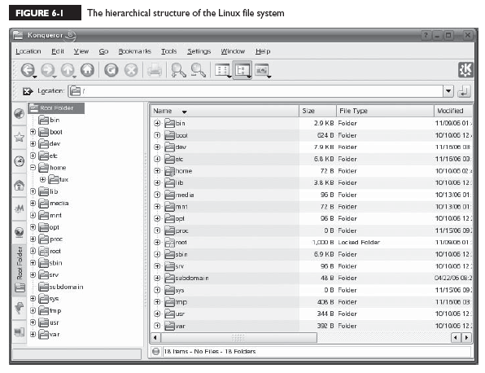
The Hierarchical Structure of the Linux File System

Slide 68
Notice that the topmost directory in the structure is the / directory, also called the root directory.
Beneath the root directory are a series of subdirectories. Specifications for how these directories are to be named are contained in the File system Hierarchy Standard (FHS)‏

Slide 69
/bin
This directory contains executable files necessary to manage and run the Linux system, including shells (such as bash) and file system management utilities such as cp and rm.

Slide 70
/boot
This directory contains your bootloader files, which are required to boot your system

Slide 71
/dev
This directory contains special files that are used to represent the various hardware devices installed in the system
EX: hda, hdb ...

Slide 72
/etc
This directory contains text-based configuration files used by the system as well as services running on the system. You can edit these files with a text editor to customize how Linux behaves

Slide 73
/home
This directory contains subdirectories that serve as home directories for each user account on your Linux system.

Slide 74
/lib
This directory contains code libraries used by programs in /bin and /sbin. Your kernel modules are also stored in the modules subdirectory of /lib.

Slide 75
/media
This directory is used by some Linux distributions (such as SUSE Linux) to mount external devices, including CD drives, DVD drives, and floppy drives.

Slide 76
/mnt
This directory is used by some Linux distributions (such as Fedora or Red Hat) to mount external devices, including CD drives, DVD drives, and floppy drives

Slide 77
/opt
This directory contains files for some programs you install on the system

Slide 78
/proc
This directory is a little different from the other directories in this list.
/proc doesn’t actually exist in the file system
Within /proc are a number of different subdirectories,Notice that each of these subdirectories is identified with a number, not a name. These numbers correspond to the process ID (PID) number of theassociated process running on the system

Slide 79
/root
This directory is the root user’s home directory. Notice that it is located separately from the home directories for other users in /home.

Slide 80
/sbin
This directory contains important system management and administration files, such as fdisk, fsck, ifconfig, init, mkfs, shutdown, and halt.

Slide 81
/srv
This directory contains subdirectories where services running on the system (such as httpd and ftpd) save their files.

Slide 82
/sys
This directory contains information about the hardware in your system.

Slide 83
/tmp
This directory contains temporary files created by you or by the system.

Slide 84
/usr
This directory contains application files. In fact, most of the application files used on your system are saved in a subdirectory of /usr

Slide 85
/var
This directory contains a variety of variable data, including your system log files

Slide 86
Types of Files Used by Linux
With a Windows file system you basically have two entry types in the file system: Directories & Files. You can have normal files, hidden files, shortcut files, word processing files, executable files, and so on.
With Linux, however, there are a variety of different file types used by the file system.

Slide 87
Linux File Types
Regular files: These files are similar to those used by the file systems of other operating systems - forexample, executable files, OpenOffice.org files, images, text configuration files, etc.
Links : These files are pointers that point to other files in the file system.

Slide 88
Linux File Types
FIFOs: FIFO stands for First In First Out. These are special files used to move data from one running process on the system to another. A FIFO file is basically a queue where the first chunk of data added to the queue is the first chunk of data removed from the queue. Data can only move in one direction through a FIFO.
Sockets: Sockets are similar to FIFOs in that they are used to transfer information between sockets. With a socket, however, data can move bi-directionally.

Slide 89
2. Complete Common File System Tasks
Navigating the file system
Managing files and directories
Running executable files
Searching the file system

Slide 90
With Linux, however, you should become proficient with the shell commands first and then use the GUI utilities for convenience
Reasons?
Most employers and co-workers won’t take you seriously as a Linux administrator if you can’t use the shell prompt. It just goes with the territory.

Slide 91
Many Linux systems, especially those deployed as servers, don’t run X Windows. Supporting a GUI environment requires a lot of CPU overhead. Many server admins prefer to devote those CPU cycles to system services instead of moving the mouse cursor on the screen. In this situation, you need to know how to do things from the shell prompt.
You need to know how to complete these tasks from the shell prompt to pass your Linux+ exam.

Slide 92
Navigating the File System
Pwd (Present Working Directory)‏
cd
ls

Slide 93
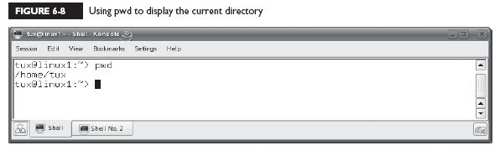
Using the pwd Command

Slide 94
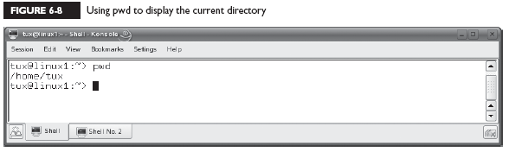
Using the cd Command

Slide 95
cd
If you enter cd at the shell prompt without specifying a path, it will automatically change directories to the home directory of the currently logged-in user.

Slide 96
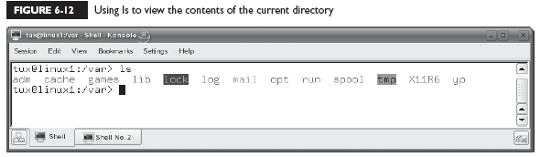
Using the ls Command

Slide 97
ls
–a Displays all files, including hidden files.
–l Displays a long listing of the directory contents. This is a very useful option. You can use it to see the file names, ownership, permissions, modification date, and size.
–R Displays directory contents recursively; that is, it displays the contents of the current directory as well as the contents of all subdirectories.

Slide 98
Managing files and directories
Creating files and directories
Viewing file contents
Deleting files and directories
Copying and moving files and directories
Creating links

Slide 99
Creating Files and Directories
touch new_file

Slide 100
Creating Files and Directories
mkdir new_directory

Slide 101
Viewing Text File Contents
cat
less
head
tail

Slide 102
cat
The cat filename command will display the specified text file on screen. This command doesn’t pause the output, so if you use it to view a long file, you may need to append |more to the command to pause the output a page a time.

Slide 103
less
The less filename command can also be used to display the specified text file on screen, much like cat. However, the less command automatically pauses a long text file one page at time.

Slide 104
head
The head filename command is used to display the first couple of lines of a text file on the screen.

Slide 105
tail
The tail filename command is used to display the last couple of lines of a text file on screen. The tail command is particularly useful when displaying a log file on screen. When viewing a log file, you probably only want to see the end of the file.
The tail command also includes the –f option, which is very useful. You can use this to monitor the file specified in the command

Slide 106
Deleting Files and Directories
rmdir
rm

Slide 107
rmdir
This utility can be used to delete an existing directory. To use it, simply enter rmdir directory_name—for example, rmdir MyFiles. Be aware, however, that rmdir requires that the directory be empty before it will delete it.

Slide 108
rm
The rm utility is a more powerful deletion utility that can be used to delete either a file or a populated directory. To delete a file, simply enter rm filename. To delete a directory, enter rm –r directory_name.

Slide 109
rm
Be careful with rm! By default, it won’t prompt you to confirm a deletion operation. It assumes that you really meant to delete the file or directory. If you want rm to prompt you before deleting a file or directory, include the –i option.

Slide 110
Copying and Moving Files and Directories
cp
mv

Slide 111
cp
This utility is used to copy files or entire directory structures from one location in the file system to another. For example, to copy a file named /tmp/schedule.txt to your home directory, you could enter
cp /tmp/schedule.txt ~.

Slide 112
mv
The mv command is used much like cp. However, it will copy the specified file to the new location in the file system and then delete the original. For example, to move a file named mylog.txt from /tmp to /var/log, you would enter mv /tmp/mylog.txt /var/log

Slide 113
mv
The mv command is also used to rename files. Simply enter mv followed by the file to be renamed and then the new file name. For example, to rename schedule.txt to schedule.old, you would enter
mv schedule.txt schedule.old.

Slide 114
Creating Links
Hard
Symbolic

Slide 115
Hard
A hard link is a file that points directly to the inode of another file. An inode stores basic information about a file in the Linux file system, including its size, device, owner, and permissions. Because the two files use the same inode, you can’t tell which file is the pointer and which is the pointee after the hard link is created.

Slide 116
Symbolic
A symbolic link file also points to another file in the file system. However, a file that is a symbolic link has its own inode. Because the pointer file has its own inode, the pointer and the pointee in the file system can be easily identified. For example, in the previous chapter, you saw that the vi file is symbolic-linked to the vim file.

Slide 117
syntax
ln pointee_ file pointer_file
Using ln without any options creates a hard link
If you want to create a symbolic link, you use the –s option

Slide 118
Running Executables
For example, you’ve used the man, vi, and cp
programs to accomplish various tasks on your system. These programs are executable files that exist in the Linux file system and are loaded into memory when you call them from the shell prompt
which command

Slide 119
You can view all of your environment variables by entering env |more or echo $PATH at the shell prompt.
To add the path to the executable to your PATH
environment variable. Enter
PATH=$PATH:new_path

Slide 120
For example, if you wanted to add a directory named apps in your vmk’s home directory to the
PATH variable, you would enter
PATH=$PATH:/home/vmk/apps
After adding the path, you must then export the new variable by entering export PATH at the shell prompt. You can then check your PATH variable by
entering echo $PATH at the shell promp

Slide 121
Searching the File System
Using find
Using locate
Using grep

Slide 122
Using find
The find utility is fantastic tool that you can use to search the Linux file system. To use find, enter at the shell prompt
find path –name “filename”
For example, suppose you wanted to find all of
the log files stored in your file system that have a .log extension. You could enter
find / –name “*.log”

Slide 123
The find utility is flexible. You can also use the –user “username” option to search for files owned by a specific user, or use the
–size “size” option to search for files of a specified size.
You can use a + sign before the size value to search for files larger than the specified size, or a – sign before the size value to search for files smaller than the specified size. The find utility has many other options

Slide 124
Using locate
The locate utility functions in much the same manner as find. However, it has one distinct advantage over find. Whenever you execute a search with find, it manually walks through each directory in the path you name in the command looking for the specified files. This process can take some time.

Slide 125
locate
Alternatively, the locate utility builds an index of the files in the file system. Then, when you execute a search, locate simply runs a query of the index. It doesn’t actually search the file system directly. The result is that locate runs much faster than find in most situations.To use locate, you must first install the findutils-locate package on your system.

Slide 126
With the index updated, you can search for files by simply entering:
locate filename
at the shell prompt. For example, if you wanted to search for a file named snmpd.conf, you could enter locate snmpd.conf

Slide 127
Using grep
Linux also provides a utility called grep that you can use to search for content within a file. Using grep, you can search through a file for a particular text string. To use grep, you would enter grep search_text file. For example, let’s suppose you want to want to search through your /var/log/messages file for any log entries related to the VNC service running on your Linux system. You would enter
grep vnc /var/log/messages

Slide 128
grep
options:
–i Ignores case when searching for the search text.
–l Doesn’t display the actual matching line of text. Only displays the names of the files that contain the matching text.
–r Searches recursively through subdirectories of the path specified.

Slide 129
3. Manage Disk Partitions
Using fdisk to create disk partitions
Building a file system with mkfs
Mounting a partition with mount
Checking the file system with fsck

Slide 130
Using fdisk to Create Disk Partitions
The fdisk utility is used from the command line to create or delete partitions at the shell prompt. To use fdisk to create a new partition, first open a terminal session. Then, at the shell prompt, change to your root account by entering su – followed by
your root user’s password.

Slide 131
fdisk
At the shell prompt, enter fdisk device. For example, if you wanted to create a partition on the third SCSI hard disk in your system, you would enter
fdisk /dev/sdc

Slide 132
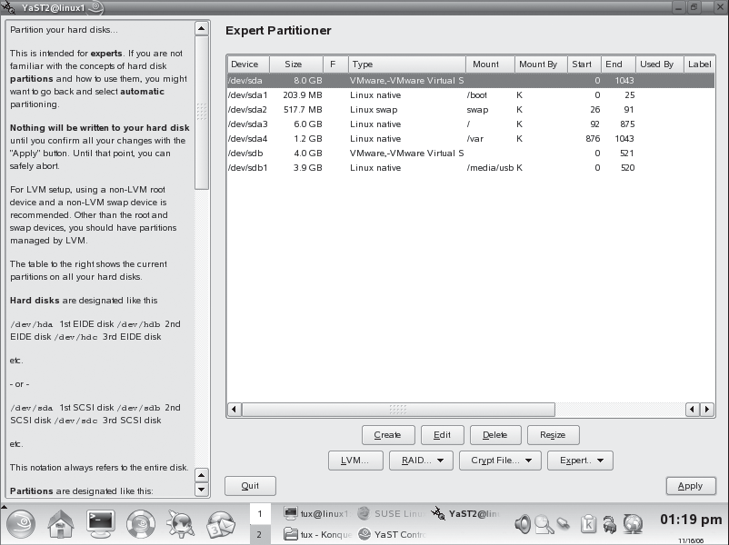

Slide 133
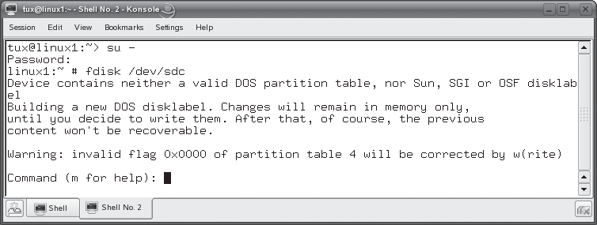
With fdisk running, you have a Command: prompt that you can use to enter fdisk commands

Slide 134
Before creating a partition, you should press P to view any existing partitions on the disk. This will help you determine if there is sufficient space and, if there is, what number must be assigned to a new partition created on the disk.
To create a new partition, you press N. You can then specify whether you want to create a primary disk partition or an extended disk partition.

Slide 135
To create a primary partition, press P when prompted.
To create an extended partition, press E
For example: You could press T and specify a partition ID of 82 if you wanted to change the
partition to a swap partition.

Slide 136
Building a file system with mkfs
Even though we’ve created a partition with fdisk, we can’t use it yet. That’s because it hasn’t been formatted with a file system yet. This is accomplished using one of the following commands:
mkfs
mkreiserfs

Slide 137
mkfs
This utility is used to make an ext2 or ext3 file system on a partition. You can even use it to create a FAT file system on the partition (which is used by Windows and DOS). You specify which file system you want to use by entering the –t option and the type of file system. For example, if you wanted to create an ext3 file system on the first partition on your third SCSI hard disk drive in your system, you would enter mkfs –t ext3 /dev/sdc1

Slide 138
mkreiserfs
This utility is used to make a Reiser file system on a partition. For example, if you wanted to create a Reiser file system on the first partition on your third SCSI hard drive in your system, you would enter
mkreiserfs /dev/sdc1
When you do, a screen is displayed and a proposal is presented. Many of these parameters can be customized using mkreiserfs options.

Slide 139
Mounting a Partition with mount
One of the key differences between Linux and other operating systems (such as Windows) is the fact that you need to mount a file system before you can use it. This is another one of those “gotchas” that trip up new Linux administrators. You even
have to mount CDs, DVDs, and floppies before you can use them!

Slide 140
Such as Windows, reference partitions on the
disk using a drive letter, such as C: or D ...
Not so with Linux! Linux instead uses a virtual file system (VFS) that creates a single hierarchy that encompasses all partitions on all storage devices in the system. Switching to the directory where the partition is mounted switches you to that partition.

Slide 141
mount
To use mount to mount a partition, first switch to your root account using su. Then enter
mount –t file_system_type device mount_point
at the shell prompt. For example,
mount –t reiserfs /dev/sdc1 /mnt/extraspace
If you don’t know what type of file system is used by the partition, you can use the –a option with mount instead of –t. This will cause mount to try to mount the partition using all supported file system types until one is successful.

Slide 142
umount
If, for some reason, you wanted to unmount a partition, you can use the umount command. To umount a partition, simply enter umount followed by the device or the mount directory for the partition. For example,
umount /dev/sdc1
or
umount /mnt/extraspace.

Slide 143
You can also use command-line utilities to create and mount swap partitions on your Linux system. You can create swap partitions using the mkswap command. First, create the partition that will be used as a swap partition using fdisk. Then enter mkswap device at the shell prompt. For example, to covert the second partition on the second IDE hard drive in your system to a swap partition, you would enter mkswap /dev/hdb2 at the shell prompt. After converting the partition to a swap partition, you need to enable it using the /sbin/swapon command.

Slide 144
Checking the File System with fsck
Syntax: fsck device
For example if you wanted to check the file system on the first partition of the third SCSI hard drive in your system, you would enter fsck /dev/sdc1. The utility will then check the file system and report any errors encountered (or the lack thereof)‏

Slide 145
4. Use Removable Media
Working with floppies
Working with optical devices
Working with USB and FireWire devices

Slide 146
Working with Floppies
Syntax: mount –t vfat device mount_point
On other distributions, such as Red Hat or Fedora, the default mount point for floppy diskettes is /mnt/floppy
EX: mount –t vfat /dev/fd0 /media/floppy

Slide 147
Therefore, you can simply enter mount /dev/fd0 at the shell prompt and the floppy will be automatically mounted using these parameters.
Before you remove a mounted floppy diskette from a drive, you must also unmount it. Just as with partitions, this is done using the umount command. To unmount a floppy, you enter umount device or umount mount_point. For example, to unmount your A: drive, you would enter umount /dev/fd0

Slide 148
Working with Optical Devices
/media/cdrom
/media/cdrecorder
/media/dvd

Slide 149
On distributions such as Red Hat or Fedora, your directories for mounting optical
devices are located in /mnt.
To mount a CD on a Linux system, insert it in your CD drive. Change to your root account and then enter mount –t iso9660 device mount_point. For example, mount –t iso9660 /dev/hdc /media/cdrom
As with any mounted file system, you should use umount to unmount a CD or DVD before ejecting it.

Slide 150
Working with USB and FireWire Devices
mount –t auto device mount_point
ex:
mount –t auto /dev/sdd /media/ THUMBDRIVE

Slide 151
5. Back Up Data
Selecting a backup medium
Selecting a backup strategy
Using Linux backup utilities

Slide 152
Selecting a Backup Medium
“old days”: floppies or a tape drive
Today, USB or FireWire hard drive

Slide 153
Selecting a Backup Strategy
Selecting a backup type
Selecting a backup schedule
Determining what to back up

Slide 154
Selecting a Backup Type
Full
Incremental: During an incremental backup, only the files that have been modified since the last backup (full or incremental) are backed up. After being backed up, each file is flagged as having been backed up.
Differential: only the files that have been modified since the last full backup are backed up

Slide 155
Selecting a Backup Schedule
You can use whatever backup schedule works best for you. However, most admins work on a weekly rotation, as discussed previously. Pick one day for your full backup and then the remaining days of the week for your incremental or differential backups. You should also schedule your backups to occur when the load on the system is at its lightest. Late in the evening or in the early morning are usually best, depending on your organization’s schedule.

Slide 156
Determining What to Back Up
/etc
/home
/opt
/root
/var
/srv

Slide 157
Using Linux Backup Utilities
Using tar
Using cpio

Slide 158
Using tar
The tar utility has been around for a very long time and is a very commonly used Linux backup tool. The acronym “tar” stands for tape archive. The tar utility takes a list of specified files and copies them into a single archive file (.tar). The .tar file can then be compressed with the gzip utility on your Linux system, resulting in a file with a .tar.gz extension.

Slide 159
tar
Syntax: tar –cvf filename directory
The –c option tells tar to create a new archive.
The –v option tells tar to work in verbose mode, displaying each file being backed up on screen.
The –f option specifies the name of the tar archive to be created.
Ex: tar –cvf /media/usb/backup.tar /home

Slide 160
To restore a tar archive, simply enter
tar –xvf filename
ex: tar –xvf /media/usb/backup.tar
If the archive has been zipped, you can also use the –z option to unzip the archive before extracting it

Slide 161
Using cpio
The cpio utility can also be used to make archive files just like tar. A key difference between tar and cpio is the fact that you must provide cpio with a list of files and directories to back up from the standard input
Syntax: cpio -ov file,directory > file.cpio
The –o option tells cpio to create a new archive. The –v option simply tells cpio to run verbosely, displaying the name of each file and directory as it’s processed

Slide 162
we could extract the archive we just created by entering cpio –iv < file.cpio

